Slide 1
Impact of PISA indexes on economic aspects: social inequality analysis
Aurélie LE DUIGOU

Slide 2
Summary
Datasets
Limits and issues
Steps and tools
Insights
Executive summary
Going further

Slide 3
Executive summary
Question
What are the Impacts of PISA indexes on some economic aspects ?
Data processing
EDA with tableau public
Cleaning data and EDA in python with pandas
Performance and correlation calculations
Countries with higher % employment = higher rates in PISA
In reading : Girl’s rate > Boy’s rate
In maths : Boy’s rate > Girl’s rate
More > rate in PISA, > % employment
More > rate in PISA, < income inequality
Corr. math/read/science-EMP(boy) < corr. math/read/science-EMP(girl)
Analysis
Conclusion

Slide 4

Datasets
Datasets from (OECD)
Countries from Europe, Asia, South America
Income inequality (1976 to 2020 ) 0<c<1
0= perfect equality , 1= perfect inequality
Employment rate(1955 to 2021)= ratio of the employed to the working age
PISA Indexes:
standardised assessment
15-year-olds in schools
4 500 and 10 000 students in each country.
PISA indexes based on several socio-economic variables such as the PISA index
of home educational resources, the PISA index of family wealth
PISA assessments based on reading, mathematics and science performance
Notes:
the Organisation for Economic Co-operation and Development
PISA = The Programme for International Student Assessment

Slide 5
Limits and issues
Missing values
Joining the 5 csv files all together
Selecting right values
Coordinate year economic datasets + year PISA datasets
Understanding the different indexes and measures
Selecting the right plots to highlight relevant informations
Analysis limited by the data given

Slide 6
Steps and tools
Exploratory analysis with tableau:
Geographical maps with PISA indexes
No specific year neither specific country at this analysis step
Exploratory analysis with pandas in python:
Data cleaning process on the merged csv
Gender analysis (boy vs girl on PISA data)
Calculating differences of performance on PISA data
Calculating differences of performance on % of employment (men vs women)
Selecting a target year for PISA data (2006), for Employment rate and Income inequality (2016)
Calculating correlation between PISA and eco. datasets

Slide 7
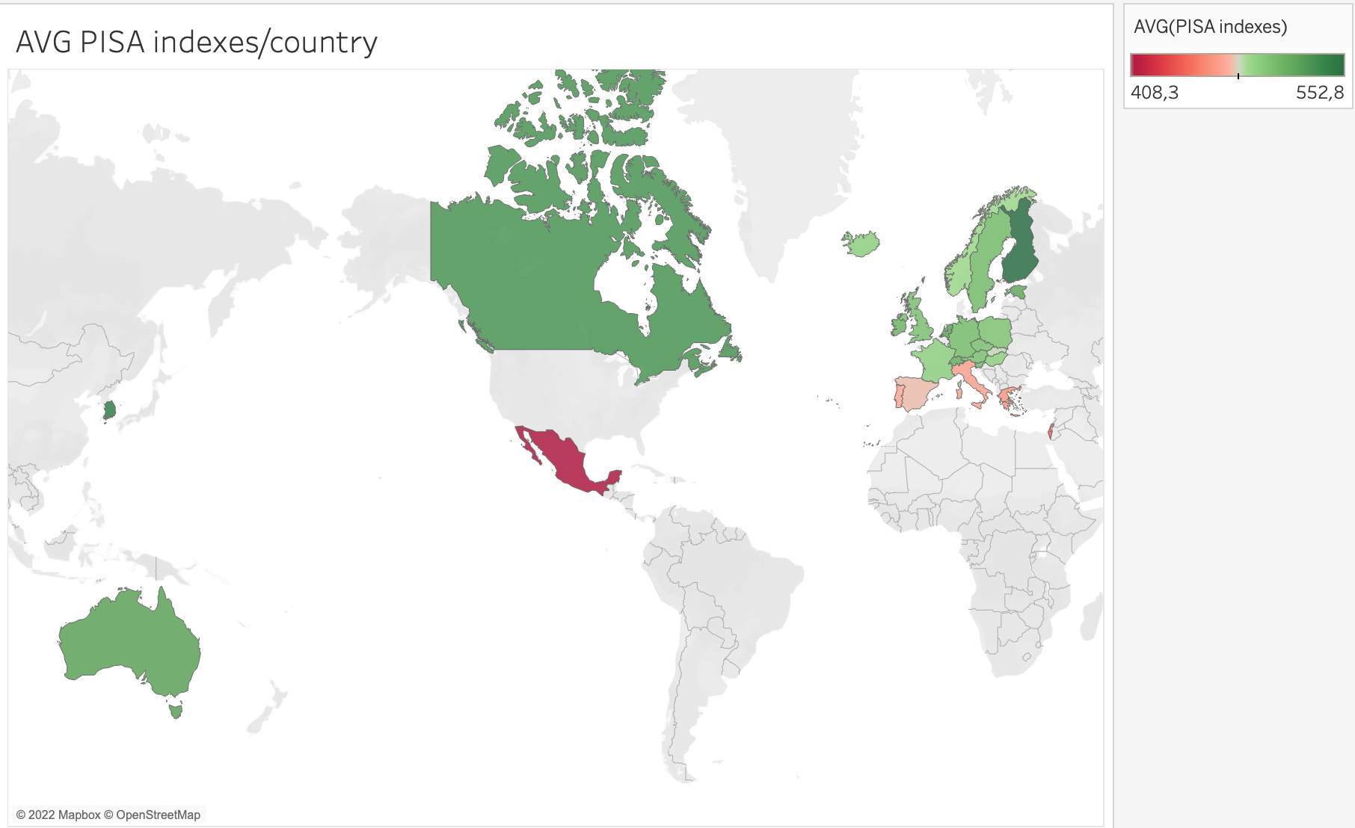
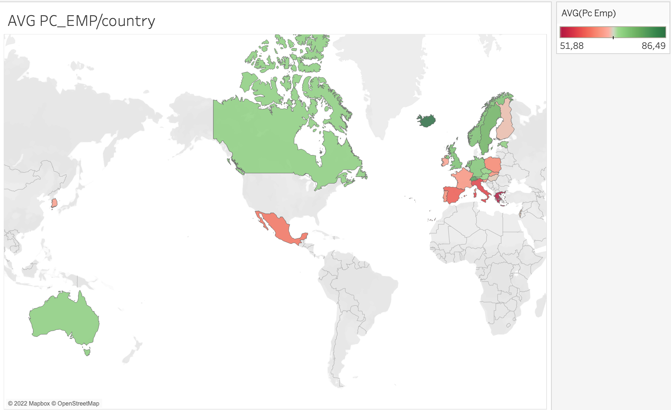
Insights
Most of countries with higher % employment = higher rates in PISA

Slide 8
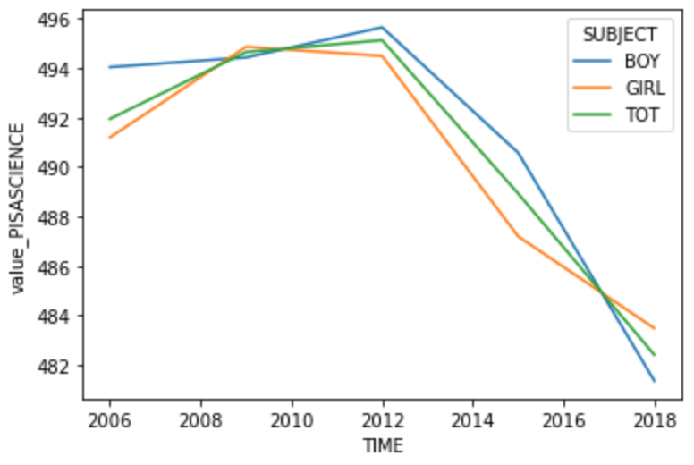
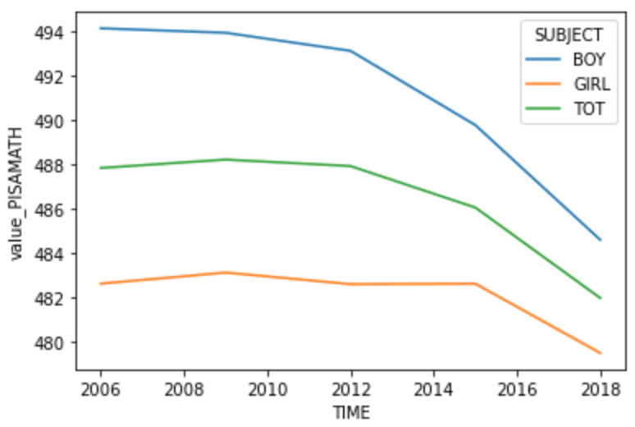
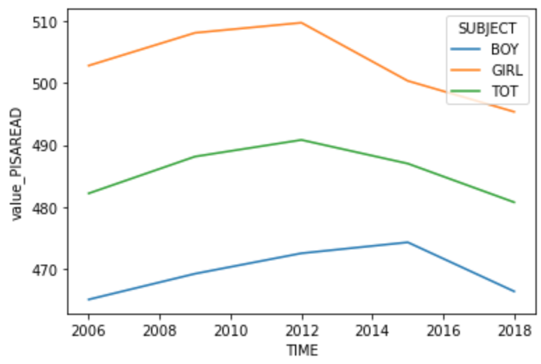
Insights(2)
In reading : Girl’s rate > Boy’s rate
In maths : Boy’s rate > Girl’s rate

Slide 9
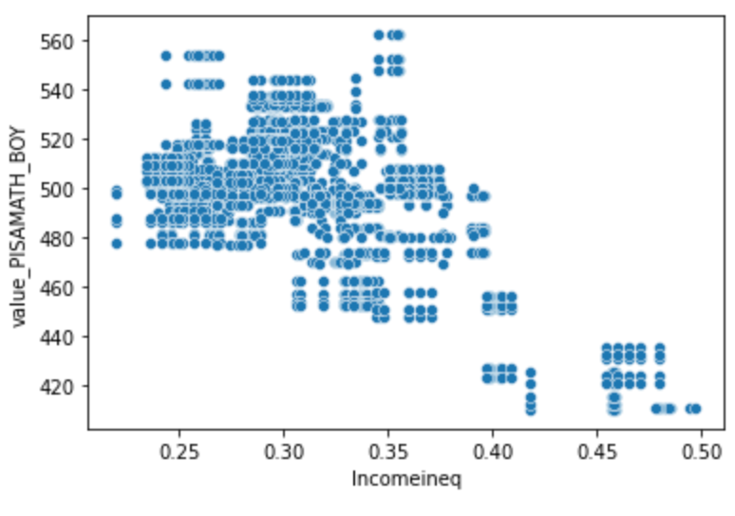
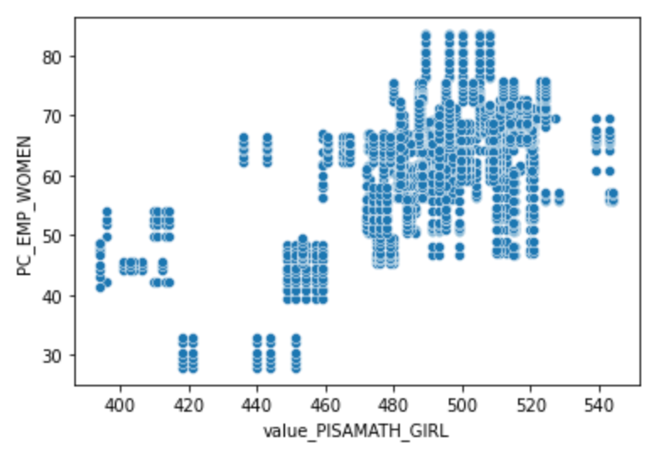
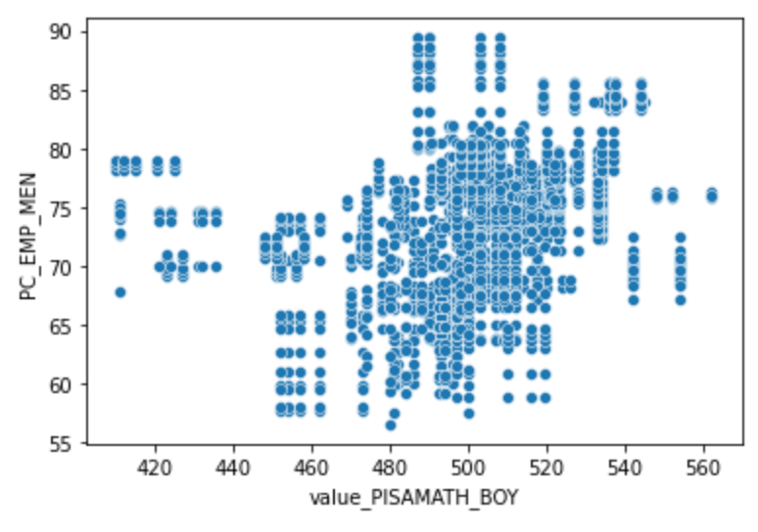
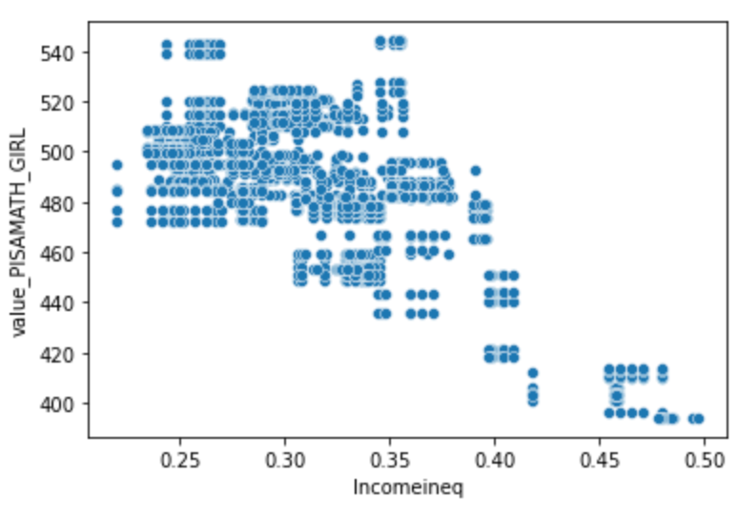
Insights(3)
More > rate in PISA, > % employment
More > rate in PISA, < income inequality
Similarities for women and men

Slide 10
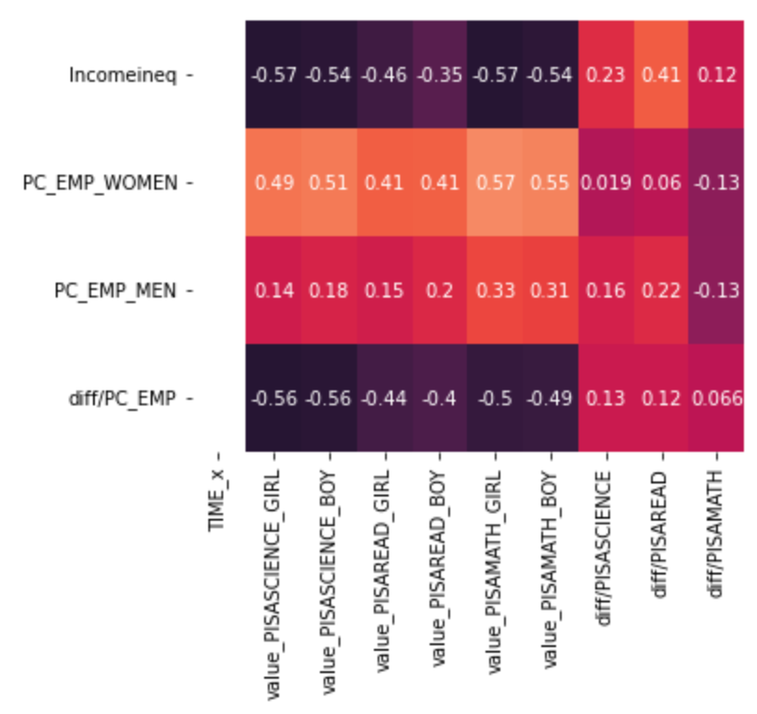
Insights(4)
Correlation matrix
PISA data from 2006
Economic data from 2016
Corr. Math-Emp(boy) < Corr. Math-EMP(girl)

Slide 11
Insights(4)
Correlation matrix
PISA data from 2006
Economic data from 2016
Corr. Math-Emp(boy) < Corr. Math-EMP(girl)
Corr. Read-Emp(boy) < Corr. Read-EMP(girl)

Slide 12
Insights(4)
Correlation matrix
PISA data from 2006
Economic data from 2016
corr. math-Emp(boy) < corr. math-EMP(girl)
corr. read-Emp(boy) < corr. read-EMP(girl)
corr. science-EMP(boy) < corr.science-EMP(girl)

Slide 13
Going further….
Analysis with other economic variables (GDP): use of linear regressions
Datasets from AFD
Analysis with 2022 PISA assessments and datasets about COVID-19

Slide 14
Thank you!

